Slide 1
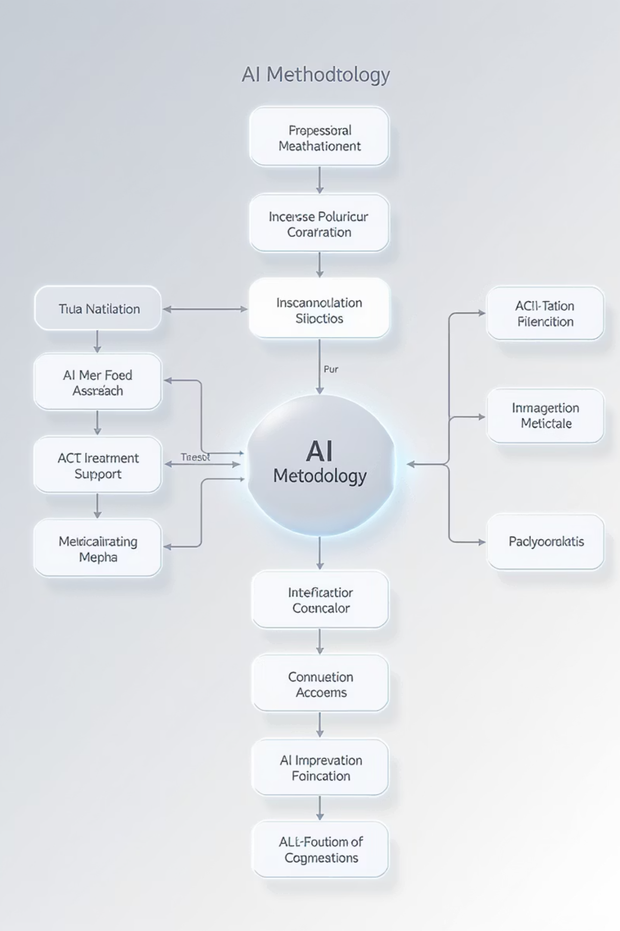

The AI Expert — AI Methodology Guide
Delivering Responsible, Measurable, and Scalable AI Solutions
At The AI Expert, we believe success with AI comes from disciplined execution, business alignment, and rigorous governance. Our proven methodology ensures AI initiatives deliver meaningful impact, while remaining ethical, transparent, and sustainable.
by Erik Schwartz

Slide 2

AI Delivery Phases
Phase 1: Discover – Align Strategy and Identify Impact
Strategic Alignment
Work closely with executive stakeholders to clarify business priorities, competitive dynamics, and targeted outcomes. AI initiatives are anchored to clear, measurable business objectives—such as cost efficiency, revenue acceleration, or enhanced customer satisfaction.
Use Case Prioritization
Map core processes and identify high-impact AI opportunities through structured evaluation of potential value, technical feasibility, and risk.
AI Readiness Assessment
Apply a comprehensive scorecard to evaluate organisational maturity across data, talent, culture, tools, and governance.

Slide 3




Phase 2: Build – Prepare Data, Tools, and Governance for Delivery
Data Audit and Preparation
Technology Selection
Assess data availability, integrity, and completeness. Resolve gaps and inconsistencies to ensure reliable AI model development.
Identify and implement the most suitable platforms and architectures, including large language models, MLOps tools, RPA frameworks, and vector databases.
Governance Framework
Agile Pilot Development
Define and embed principles for bias mitigation, data privacy, transparency, intellectual property management, and explainability. Establish governance processes for approvals and oversight.
Design and execute small-scale pilots that deliver fast learning cycles and de-risk investment.
Extensive Partner Network: Leverage The AI Expert's trusted ecosystem of technology and implementation partners to accelerate delivery and ensure technical excellence.

Slide 4




Phase 3: Validate – Test, Measure, and Refine
Human-in-the-Loop Validation
Ensure outputs are reviewed by domain experts prior to automation at scale. AI augments human decision-making rather than replacing it blindly.
Performance Measurement
Monitor model accuracy, fairness, efficiency, and business outcome KPIs.
Iterative Refinement
Apply insights and feedback to improve models, data pipelines, and user interfaces on an ongoing basis.

Slide 5

Phase 4: Deploy – Scale for Operational Impact
Infrastructure Scaling
Expand computing, storage, and MLOps/ModelOps pipelines to handle production workloads securely and efficiently.
Workflow Integration
Embed AI models into core systems and processes so that AI-driven insights and automation are part of everyday operations.
Change Management
Provide training, documentation, and communications to support adoption across the organisation.
Extensive Partner Network: Draw on The AI Expert's delivery partners for scalable, production-grade solutions that align with your business goals.

Slide 6








Phase 5: Govern and Iterate – Sustain Performance and Compliance
Continuous Monitoring
Regular Audits
Track model performance, bias, and drift. Ensure timely updates and retraining.
Conduct periodic reviews of data pipelines, model decisions, and business impact to maintain compliance and integrity.
Ongoing Optimisation
Business Reporting
Continuously enhance models, processes, and governance frameworks to adapt to evolving needs.
Provide transparent reporting of AI outcomes against agreed success metrics.

Slide 7

Guiding Principles
Business-First AI
Every AI initiative is tied to a clearly defined and measurable business outcome.
Responsible and Ethical by Design
Governance, transparency, and human oversight are embedded from the outset.
Outcome-Driven Delivery
We measure success through tangible business results, not technology demonstrations.
Scalable Architecture
Solutions are designed to grow with your organisation's ambitions.
Collaborative Execution
Our partner network ensures rapid deployment, deep technical expertise, and resilient solutions.

Slide 8

Contact Us
Erik Schwartz
AI Implementation Specialist
Phone: +44 7946 235391
Let's discuss how our AI methodology can transform your business operations and drive measurable results.

